Slide 1
Cardio Pulse Guardian
A Machine Learning Model for Cardiovascular Risk Detection and Management
Course Project | TTDS | 2324 Waqas DS019 Emmad DS005

Slide 2
Introduction & Background
Cardiovascular diseases (CVDs) are a leading cause of global mortality, accounting for approximately 17.9 million deaths annually
Cardiovascular Diseases (CVDs) Statistics
CVDs contribute to 31% of all deaths worldwide.
Four out of 5 CVD deaths result from heart attacks and strokes.
Onethird of these deaths occur prematurely in individuals under 70 years of age.

Slide 3

Cardio Pulse Guardian
Cardio pulse Guardian is our response to this critical issue, presenting a machine learning model for early detection and effective management of high cardiovascular risk individuals.

Slide 4
Project Possible Outcomes
Early Detection: Apply classification models (Logistic Regression, Gradient Boosting, Random Forest) for early identification of high cardiovascular risk individuals.
Effective Management: Utilize both supervised and unsupervised learning. Supervised learning tailors personalized management, while unsupervised learning (clustering) reveals patterns for targeted interventions.
Global Impact: Employ scalable solutions for largescale early risk identification (classification) and diverse health profile understanding (clustering)
Research Advancement: Use advanced techniques to contribute insights into cardiovascular risk factors and management strategies. Combining supervised and unsupervised learning enhances research comprehensiveness.

Slide 5

Dataset Overview
The Cardiopulse Guardian model is trained on a comprehensive dataset available at Kaggle.
This dataset comprises 11 crucial features used to predict the likelihood of heart disease.

Slide 6
Key Features To Predict Likelihood of Heart Disease
Age: Age of the patient [years]
Sex: Sex of the patient [M: Male, F: Female]
ChestPainType: Chest pain type [TA: Typical Angina, ATA: Atypical Angina, NAP: NonAnginal Pain, ASY: Asymptomatic]
RestingBP: Resting blood pressure [mm Hg]
Cholesterol: Serum cholesterol [mm/dl]
FastingBS: Fasting blood sugar [1: if FastingBS > 120 mg/dl, 0: otherwise]
RestingECG: Resting electrocardiogram results [Normal: Normal, ST: having STT wave abnormality]
MaxHR: Maximum heart rate achieved [Numeric value between 60 and 202]
ExerciseAngina: Exercise induced angina [Y: Yes, N: No]
Oldpeak: Oldpeak = ST [Numeric value measured in depression]
ST_Slope: The slope of the peak exercise ST segment [Up: upsloping, Flat: flat, Down: downsloping]

Slide 7
Key Features To Predict Likelihood of Heart Disease
1. Chest Pain Type: Describes the kind of chest pain someone feels.
2. Resting Blood Pressure (RestingBP): Shows how hard the blood pushes against the vessel walls when a person is at rest.
3. Serum Cholesterol: Indicates the level of fat in the blood, affecting heart health.
4. Fasting Blood Sugar (FastingBS): Checks if blood sugar is high after not eating for a while.
5. Resting Electrocardiogram Results (RestingECG): Records how the heart works at rest.
6. Maximum Heart Rate Achieved (MaxHR): Shows the fastest heart rate during intense activity.
7. Exercise-Induced Angina (ExerciseAngina):Indicates if chest pain occurs during exercise.
8. Oldpeak: Describes the decrease in a specific part of the heart's electrical signal.
9. The Slope of the Peak Exercise ST Segment (ST_Slope): Describes the shape of the heart's electrical signal during intense activity.

Slide 8
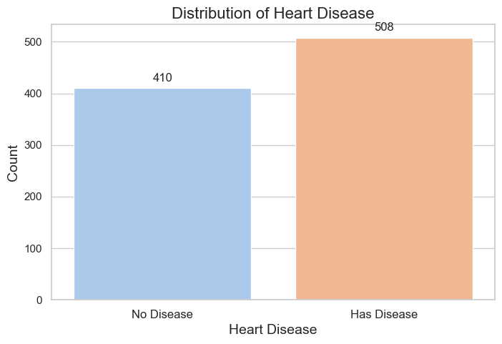
Target Variable
Our goal is to predict the likelihood of heart disease (HeartDisease) based on the provided dataset.

Slide 9
Data Preprocessing
Data Cleaning and Feature Transformation

Slide 10
Dataset Composition
12 variables in total (1 dependent, 11 independent)
7 numerical features: Age, RestingBP, Cholesterol, MaxHR, Oldpeak
5 categorical features: Gender, ChestPainType, FastingBS, RestingECG, ExerciseAngina, ST_Slope
No apparent missing values under normal circumstances.
Caution: Potential hidden missing values.

Slide 11
Steps For Data Cleaning
Performing data cleaning to get the data ready for the next step. It involves the following steps:
Fix missing values (Imputation can be considered)
Remove duplicate values (where needed)
Check Data Types beforehand

Slide 12
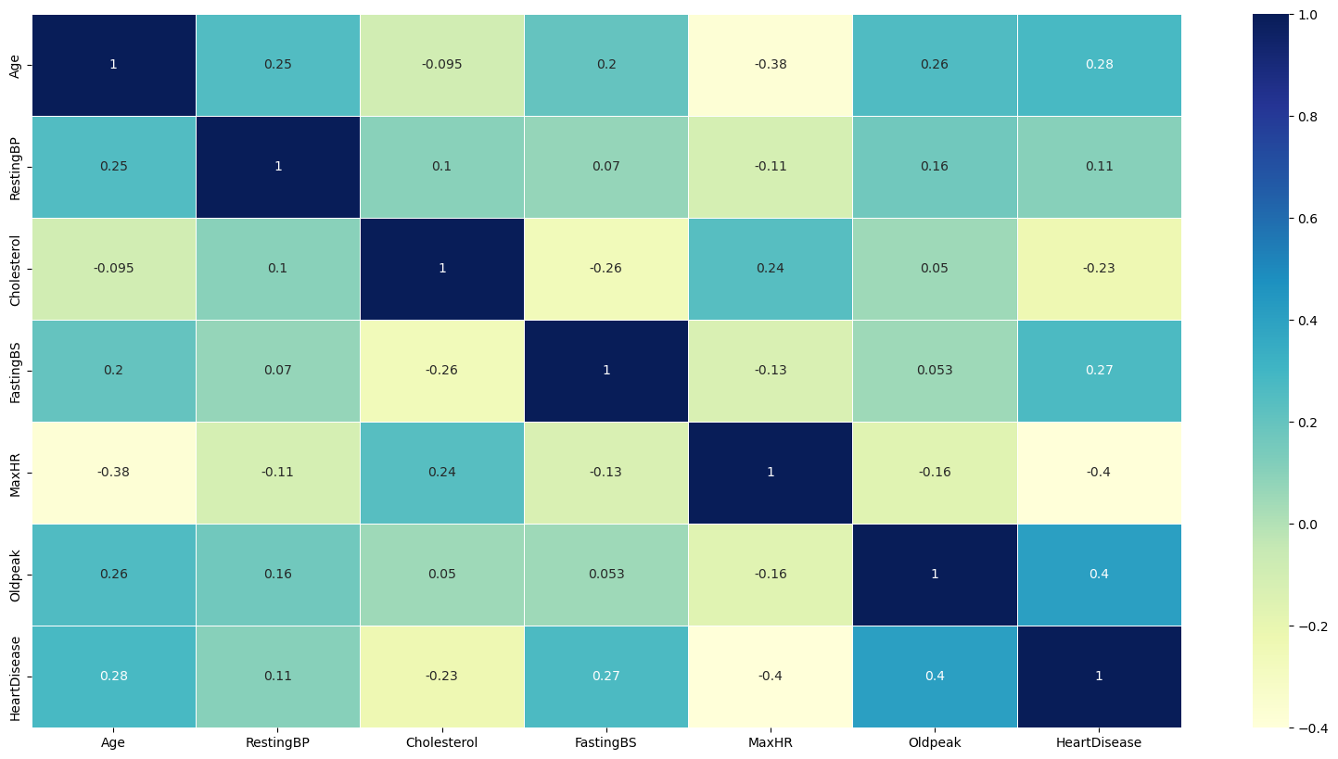
Correlation Heatmap

Slide 13
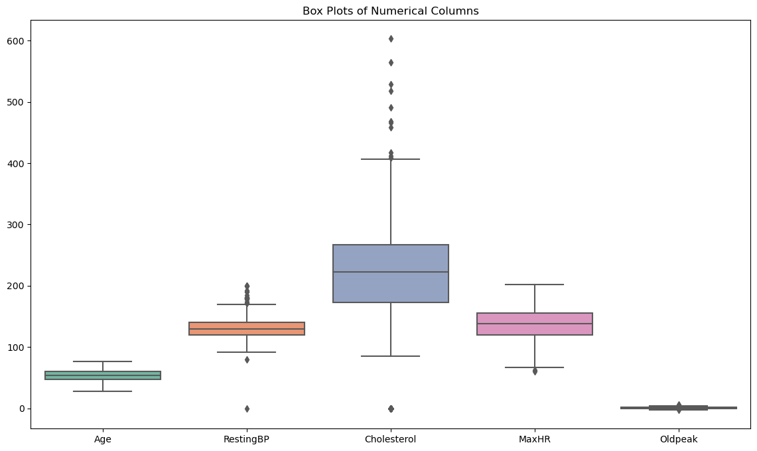
Box Plot of Numerical Feature Indicating Outliers

Slide 14
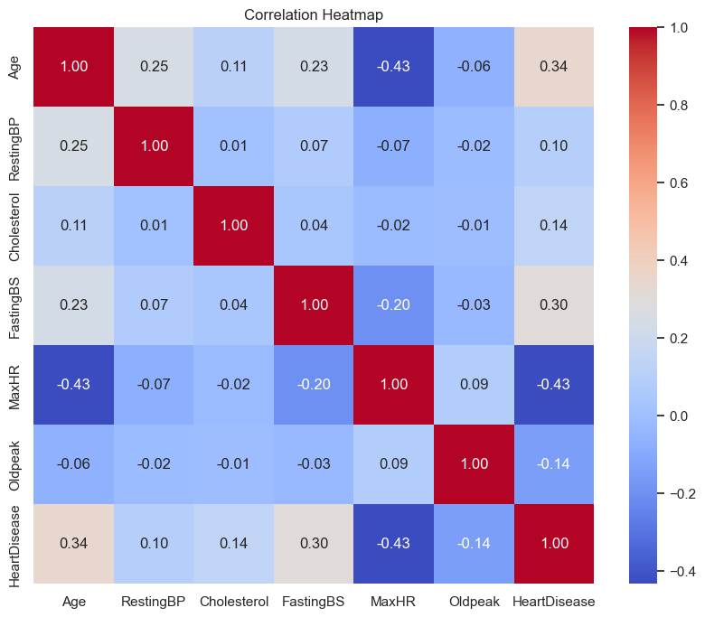
Correlation Heatmap After Removing Outlier

Slide 15
Observation
We have not found any significant changes in correlation before and after removing outlier.
We prefer to go with our complete dataset.

Slide 16
Imputation of Missing Values
Initial data check revealed no missing values.
Noticed 0 values in numerical columns (["Age," "RestingBP," "Cholesterol," "MaxHR"]).
Treated 0 values as potential null values within practical ranges.
Replaced 0 with NaN and identified three columns with null values.
Utilized imputation techniques to address missing values in these columns.

Slide 17
Exploratory Data Analysis
Visualizing key parameter and finding their trends and insight

Slide 18
Exploring Age Group and Heart Disease Methodology
The relation between the age groups and cardiovascular disease will be found by :
investigating the impact of age on cardiovascular risk by categorizing individuals into different age groups.
Analyzing age distributions, prevalence of cardiovascular risk factors, and correlations with other health indicators to gain insights into how age influences the likelihood of heart disease in the dataset.

Slide 19
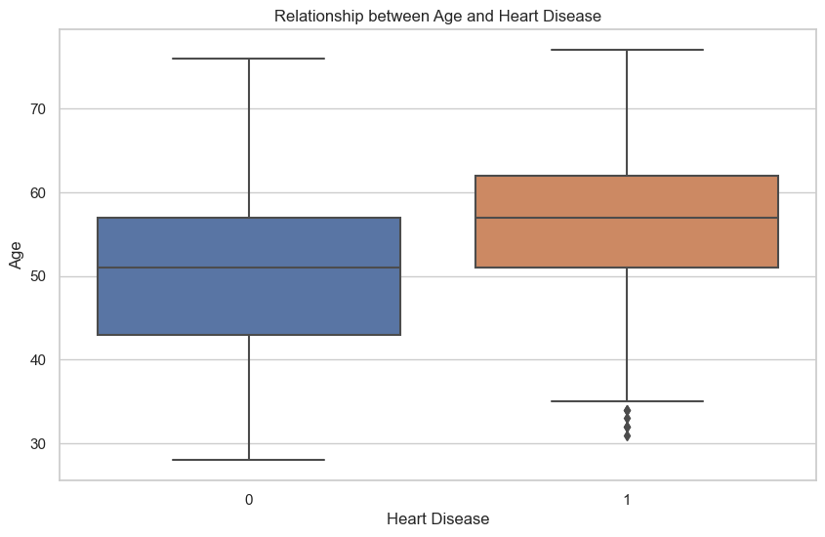
Exploring Age Group and Heart Disease

Slide 20
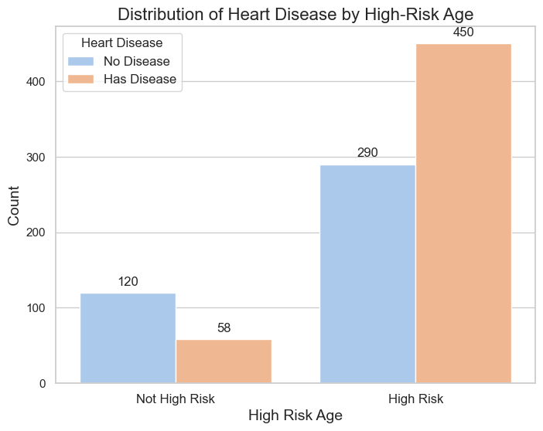
Exploring High Risk Age Group and Heart Disease

Slide 21
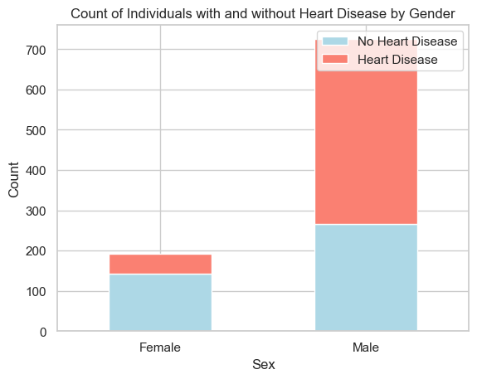
Heart Disease Relation with Gender

Slide 22
Outcome Of Heart Disease Incidence in Male
Despite a substantial representation of males in the dataset, the observed percentage of individuals with heart disease among males remains high.
This suggests a potential gender-related pattern in heart disease incidence, warranting further investigation and consideration in the overall analysis.

Slide 23
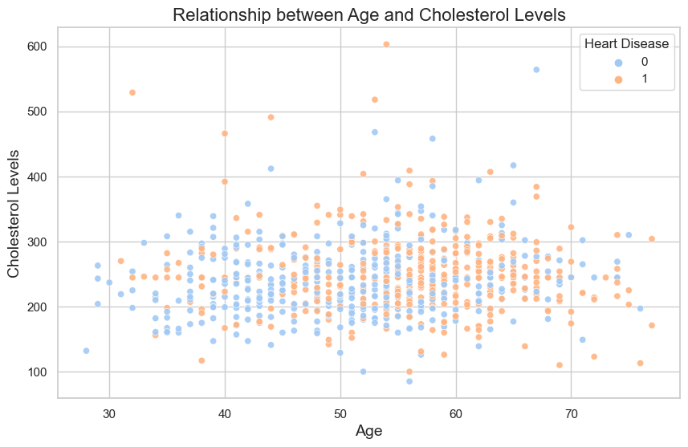
Relationship Between Cholesterol and Age

Slide 24
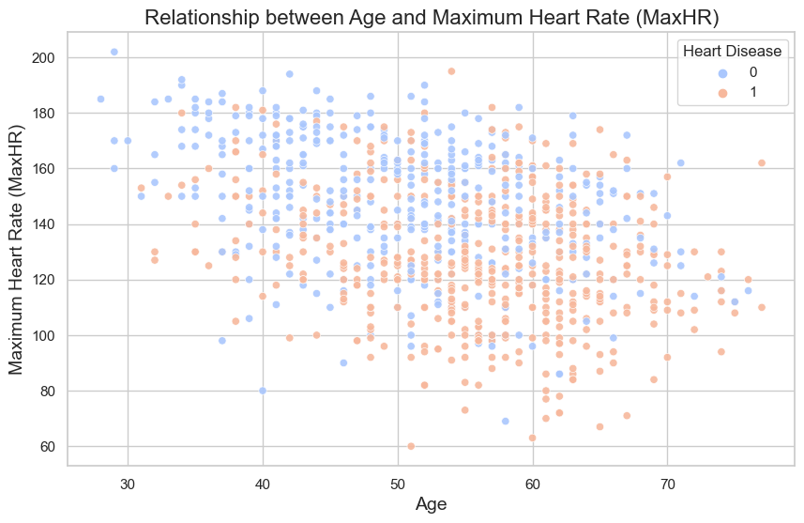
Relationship Between Max Heart Rate and Age

Slide 25
Insights
Age vs. Cholesterol Levels:
The scatter plot reveals a varied distribution of cholesterol levels across different age groups. Individuals with heart disease tend to exhibit a diverse range of cholesterol levels, suggesting that cholesterol alone may not be a decisive factor in cardiovascular risk.
Age vs. Maximum Heart Rate (MaxHR):
The scatter plot illustrates the relationship between age and maximum heart rate (MaxHR) for individuals with and without heart disease. There seems to be a subtle negative correlation, with older individuals generally showing a lower maximum heart rate, particularly among those with heart disease. The distribution of MaxHR varies significantly, emphasizing the need for further investigation into factors influencing cardiovascular fitness with age.

Slide 26
Analyzing Resting Blood Pressure with Age
In order to analyze resting blood pressure with age, following procedure was followed:
Exploring the distribution and impact of resting blood pressure on cardiovascular health.
Investigating statistical measures, visualize the relationship between blood pressure and heart disease, and identify patterns that may contribute to risk assessment.

Slide 27
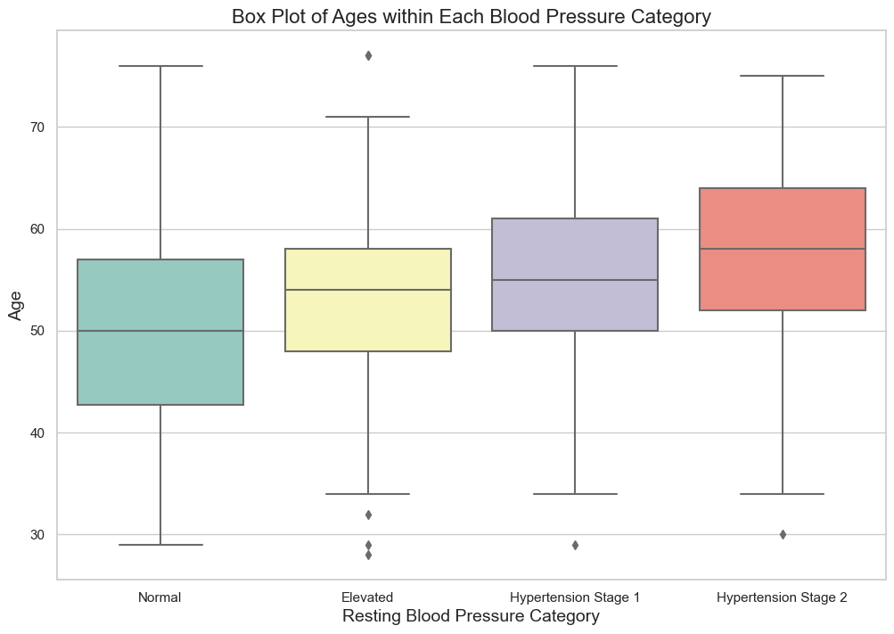
Analyzing Resting Blood Pressure with Age

Slide 28
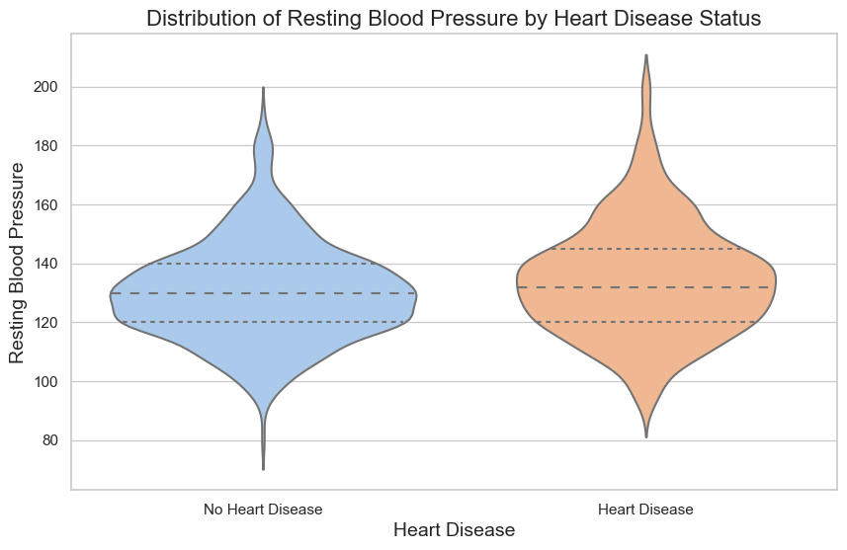
Distribution of Resting Blood Pressure And Heart Disease

Slide 29
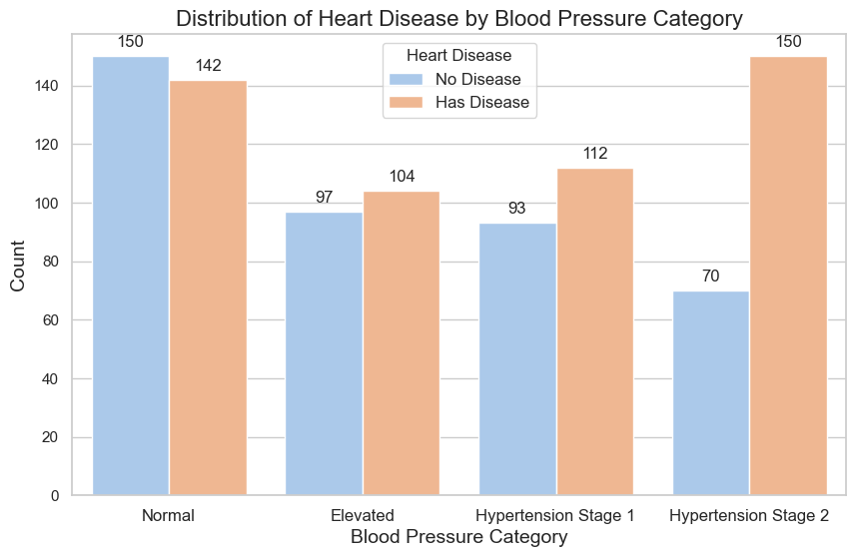
Distribution of Heart Disease By Blood Pressure Category

Slide 30
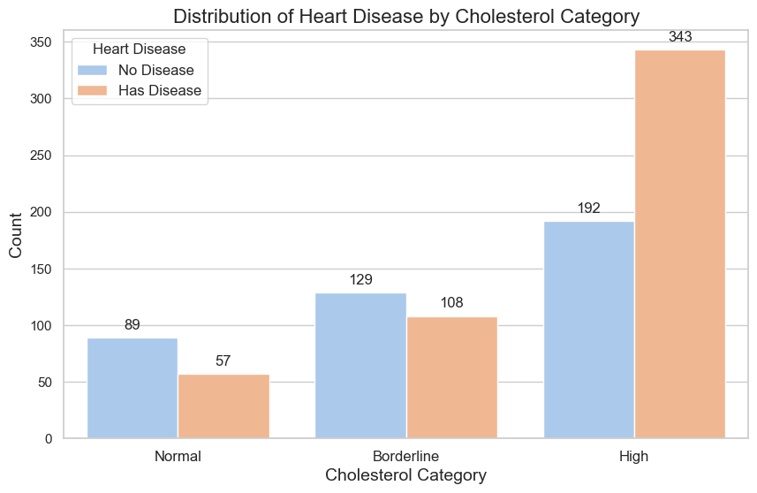
Distribution of Heart Disease By Cholestrol Category

Slide 31
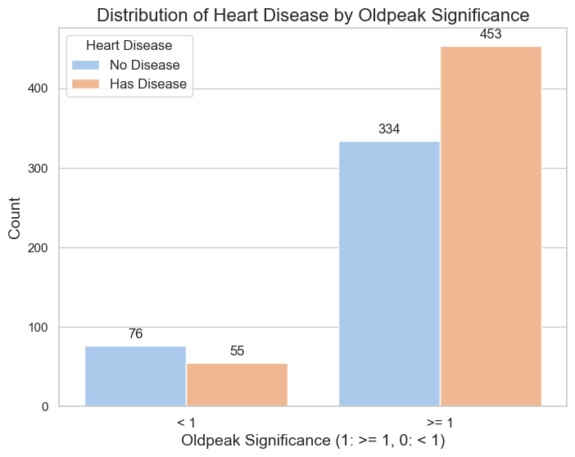
Distribution of Heart Disease By Old peak

Slide 32
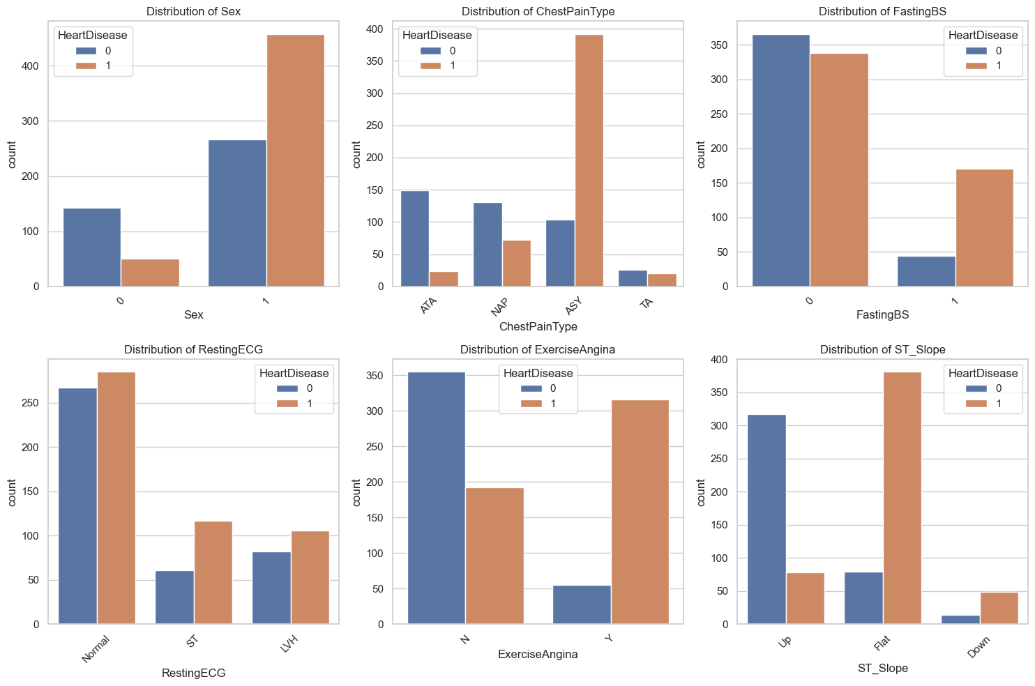
Analyzing Categorical Features

Slide 33
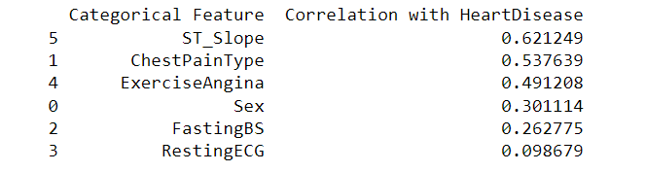
Correlation of Categorical Feature By Cramér’s V Method

Slide 34
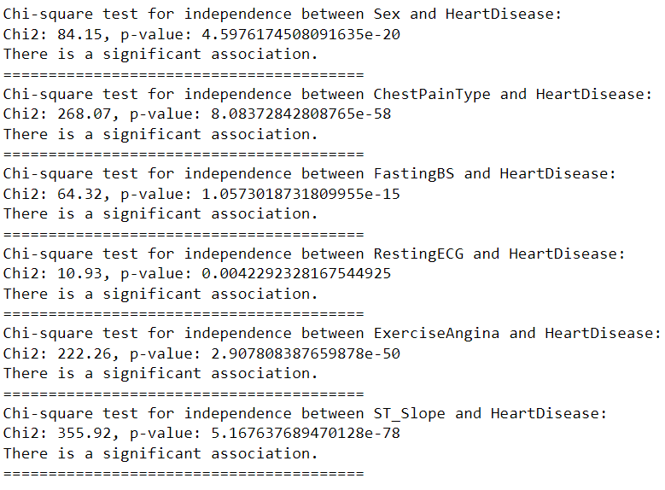
ChiSquare Test for Independence

Slide 35
Machine Learning Model
We selected three machine learning model for our heart disease predictive model.
Random Forest
Gradient Boosting
Logistic Regression

Slide 36
Machine Learning Model
We applied our ML model in three different ways.
On over all data
By selecting feature
By selecting feature with cross validation
Let’s discuss performance of each method one by one.

Slide 37
Machine Learning Model On Over All Data
Machine Learning Model | Model Accuracy
Logistic Regression | 86.4 %
Random Forest | 86.5%
Gradient Boosting | 85.86%

Slide 38
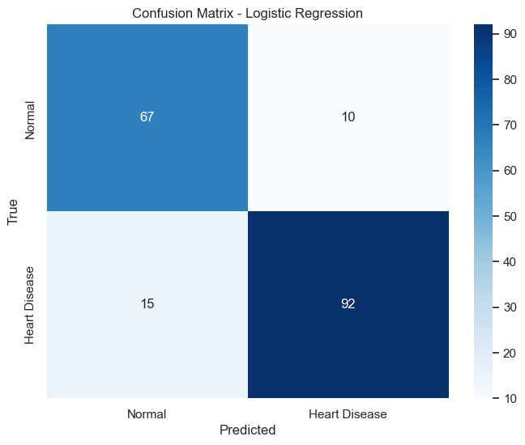
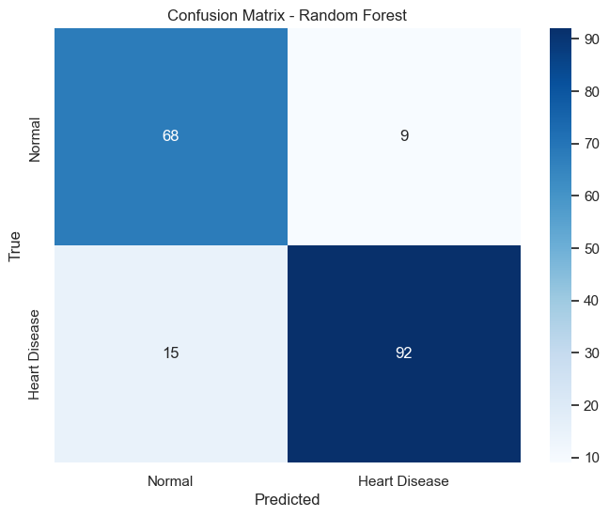
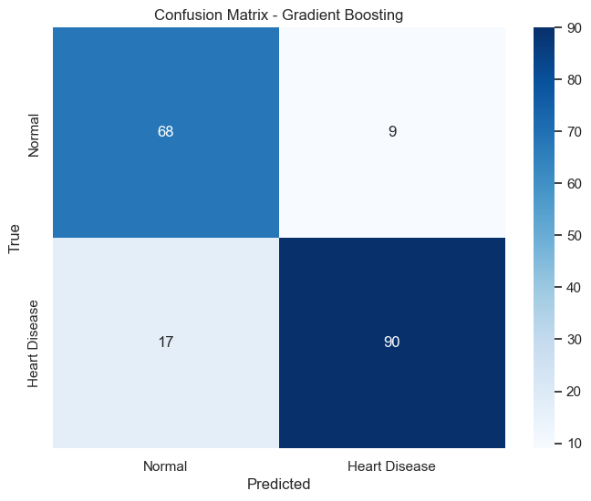
Confusion Matrices

Slide 39
Machine Learning Model On Selected Feature
Following are the categorical feature we selected for our model.
ChestPainType
RestingECG
ExerciseAngina
ST_Slope
RestBP_Category
CholesterolCategory
MaxHRCategory
Following are the numerical feature we selected for our model.
Gender
FastingBS
Oldpeaksignificant

Slide 40
Machine Learning Model On Selected Features
Machine Learning Model | Model Accuracy
Logistic Regression | 87.5 %
Random Forest | 84.24%
Gradient Boosting | 85.87%

Slide 41
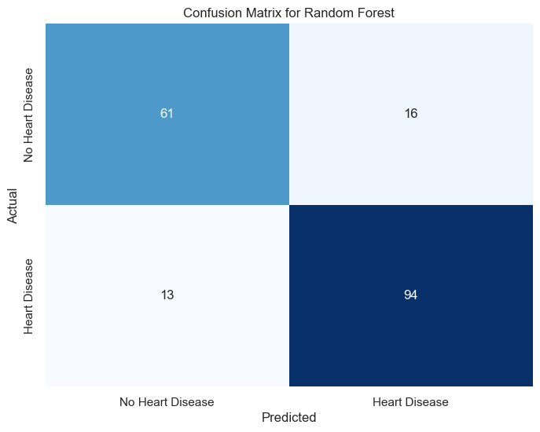
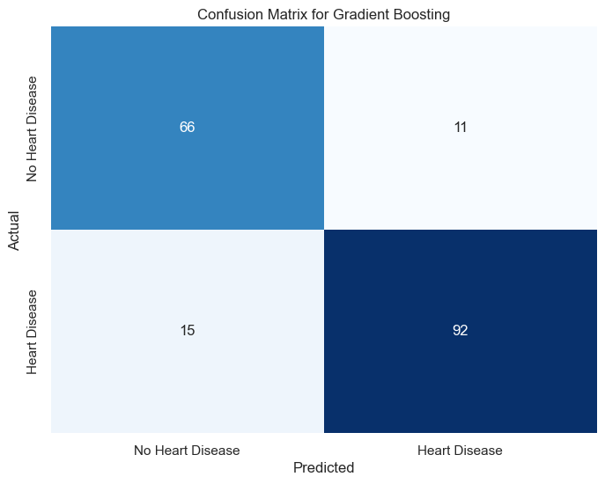

Confusion Matrices

Slide 42
Machine Learning Model On Selected Features With Cross Validation
Machine Learning Model | Model Accuracy
Logistic Regression | 87.5 %
Random Forest | 86.41%
Gradient Boosting | 86.96%

Slide 43
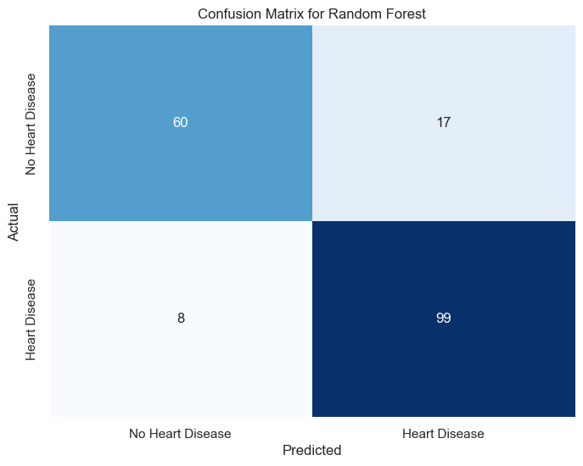
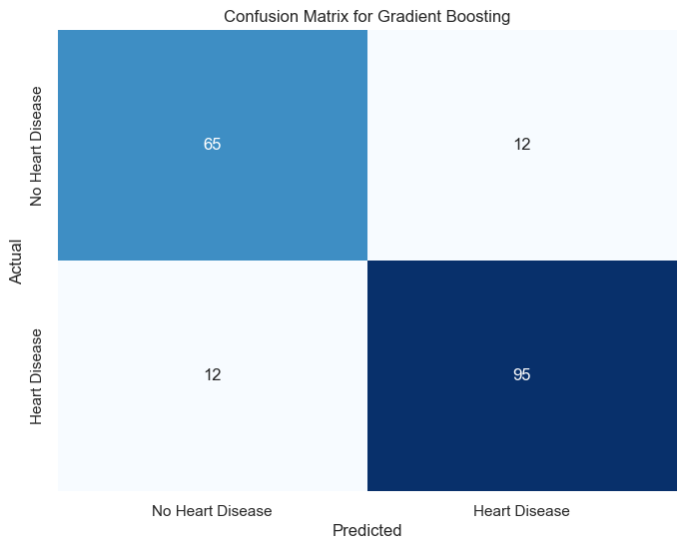
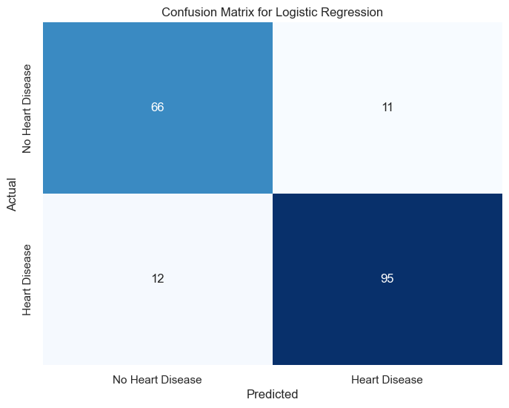
Confusion Matrices

Slide 44
Conclusion
As recall value of Random Forest with feature selection and cross validation is 93% for predicting presence of heart disease in heart patient, which is also greater than any other model. Hence, we chose this model as our final model.

Slide 45
Future Work
We will try to gather more data to increase accuracy of model.
We will acquire more domain knowledge for further feature selection.
We will consider disease to incorporate in our machine learning model.

Slide 46

THANK YOU
ANY QUESTIONS?

